Slide 1
HANDS-ON CONSUMER-DRIVEN CONTRACT TESTING USING PACT

Slide 2
LEARNING EXPECTATION
Pre-requisite
Familiarity with Microservice architecture
Definition of “Contract Testing”
Goal
Understand contract testing.
Understand consumer-driven contract testing.
Contract testing vs Schema testing
Able to write simple consumer-driven Contract test for HTTP/HTTPS Integration between system using Pact-JVM - Maven/Junit5/Springboot (pact language-framework support)
Contract sharing using pack-broker called Pact Flow.
Out of scope
Message Integration contract tests.
Nitty-gritty of Pact tool.
Bi-directional Contract Testing using PactFlow - https://pactflow.io/bi-directional-contract-testing/

Slide 3
PARTICIPANTS RESPONSIBILITY
Practice
Team collaboration
Revisit the session.
Most IMPORTANT
Have Fun & Enjoy Learning ☺.
Try implementing the consumer contraction generation using Pact.
Verify Provider using Pact Consumer Contract.
Try to get the answer from Google or official pact documentation before posting in Group chat.
Use Team chat group to post queries.
Try answering other participants query in the Group Chat
Don’t expect much from the Instructor ☺

Slide 4
CREDITS & DISCLAIMER – Just to be SAFE ☺
Consumer & Provider application and the content used in the session is from “Microservice Contract Testing with Pact” by Rahul Shetty from Udemy platform.
Not an affiliate.
Only for educational purpose.
Other resources used:
IntelliJ IDEA Community Edition by Jetbrains - https://www.jetbrains.com/idea/
Pact library - https://pact.io/
Docker Desktop for Windows – https://docker.com
Oracle 21c Enterprise Edition Image from Oracle Container Registry - https://container-registry.oracle.com/
SQLDeveloper Oracle Client – https://www.oracle.com/in/database/sqldeveloper/

Slide 5
SESSION PLAN
Session 1
Introduction
Case Study - Life without Contract Testing
Contract Testing
How Pact contract testing works?
Session 2 - Test application setup
Session 3 – Pact: Consumer Implementation
Session 4 – Pact: Provider Implementation
Session 5
Pact Flow: Contract sharing & verification
Practice task
Session 6 – Q&A and Doubt resolution on practice task

Slide 6
SESSION 1
Case Study - Life without Contract Testing
Contract Testing
How Pact contract testing works?

Slide 7
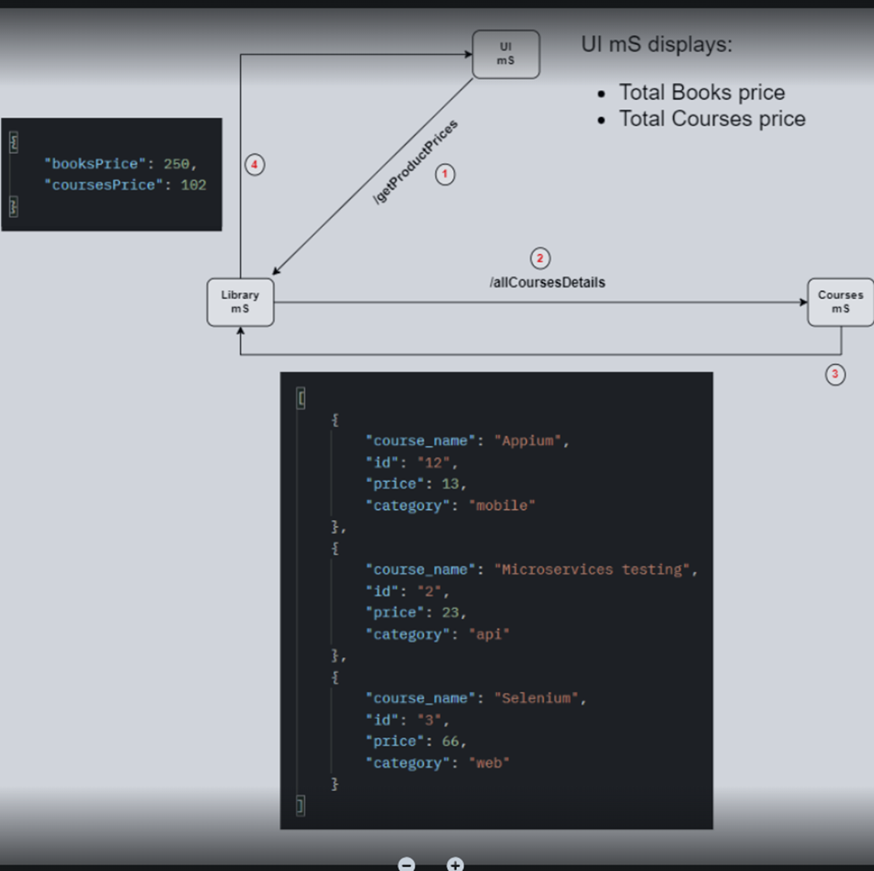
Case Study Life without Contract Testing
Test application architecture
Functional flow

Slide 8
Case Study Life without Contract Testing
Courses mS teams share the contract with the Library mS team and development started for both services.
Library mS
During development, the Library mS will mock the Courses mS /allCourseDetails endpoint as per the agreed contract or specification and unit test the functionality to calculate the total course price.
Note that the purpose of unit tests is to test the application or service functionality in an isolated manner without depending upon the availability of external services. If there is any external service dependency, then that will be mocked and tested.
Courses mS (No dependency)
Similarly, Courses mS will also have their unit tests to make sure its methods and functionalities working as expected.
Feature development phase

Slide 9
Case Study Life without Contract Testing
Unit testing and QA validation are completed for both Library & Courses mS on a lower environment, say, DEV environment.
Now both services were deployed to the Integration Test Environment (ITF) for integration testing.
As soon as the integration testing team started testing and performed the /getProductPrices call from UI ms. Surprisingly, the ITF team got 500 Internal Server Error, instead of a successful response.
All three mS teams connected to triage the issue.
Library mS team.
Courses mS team.
ITF team
After successful triage, the teams found the root cause of the failure.
The reason for the failure is that in the response of /allCourseDetail call of Courses mS (producer) “price” attribute changed to “pricing” which caused Library mS (consumer) to fail.
Integration phase

Slide 10
Case Study Life without Contract Testing
Why did unit tests not catch this breaking change?
Because we mocked the response of the Courses mS /allCourseDetails call.
Why have you mocked the Courses mS /allCourseDetails call?
Unit tests should test in isolation with stubbing/mocking the dependencies.
Why did you mock the wrong response?
The mock response is as per the spec/contract shared by Courses mS for /allCourseDetails call.
We didn’t mock the wrong response. The response for the /allCourseDetails call is not as per the agreed contract.
What is the exact reason for failure?
Library mS parses the response of /allCourseDetails call and fetches the “price” field to sum up the prices of all courses
Since Courses mS has changed the contract and now sending that field as “pricing”, the Library mS is unable to find the “price” field and parsing failed.
Unit tests will not be able to catch such issues/changes. Because the unit test uses a mock response as per the contract which contains the “price” field. So, unit tests got passed.
But when the ITF team started testing with real services being deployed in ITF, it broke, since the “price” field was not present in the response of /allCourseDetails call.
Manager of consumer
(Library mS team)

Slide 11
Case Study Life without Contract Testing
Why did you not update the changes to the consumers (Library mS)?
There are many teams consuming our service and we’re not sure which team is using what field. So, we just updated our spec/contract for the changes we made.
And is the consumer’s responsibility to adhere to and accommodate the changes according to the latest spec/contract.
How a consumer can monitor these contract changes every time, if the provider doesn’t reach out to the consumer for the exact changes made?
Why worry?
QA team will however catch these issues on their ITF/E2E test environment, and we will fix it.
Isn’t that too late? We’re in the agile world and contract change issues should be identified early in the life cycle. And we’re dependent on a total of 7 providers for fetching the business data.
How can we keep track of all such contract changes?
Is there any tool where we can define our expectations (contract) and the fields that we’re using?
That is, the provider unit test cases will start failing if they alter those fields.
In that way, the provider will know which consumers are getting impacted by the change and inform those consumers. So that the consumer can update those changes on their end. As a result, we can prevent integration bugs that happen due to contract differences.
Questions to the provider
(Courses mS team)

Slide 12
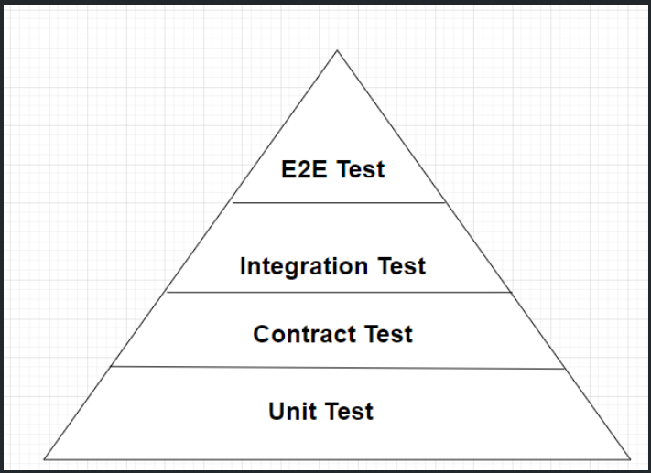
Contract Testing
Contract testing is the way of testing communication or the contract between two services in a Microservice architecture.
Without contract testing, the only way to ensure that applications will work correctly together is by using expensive and brittle integration tests.
By using contract testing, we can catch integration bugs related to contract differences, early in the development life cycle, that is at the unit test level, and fix them.
But this doesn’t replace the actual integration testing which helps to identify the following:
application connectivity issue.
missing or Invalid data issues such as
incorrect date format,
non-numeric data,
data length or format issues, etc.

Slide 13
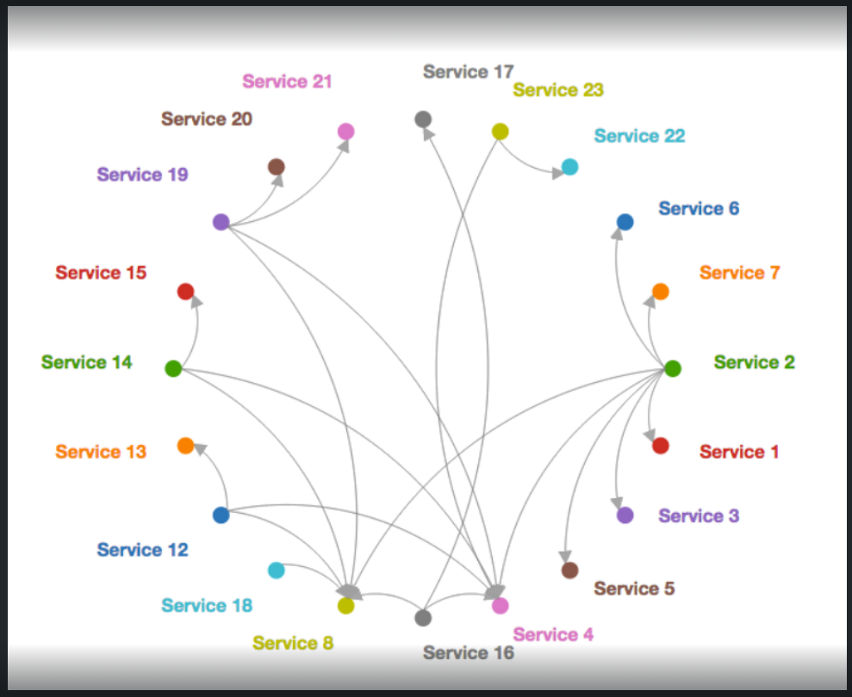
Contract Testing (cont.)
It will also prevent producer applications from introducing breaking changes that will impact its consumer services.
In case, the producer tries to change anything in the contract that will impact the consumer, then the contract tests will fail at the producer’s end.
This way producers will know which consumers are getting impacted and inform them to accommodate those changes.
Thus, contract testing ensures and maintains the contract between the producer and consumer.
Also, contract testing helps to understand the producer-consumer dependency relationship and somewhat creates documentation that contains information about:
What are the Producer services and their consumers?
What are the producer services on which the consumer depends?
Which consumer is using what fields or data from the provider service?
The most popular tool for contract testing is Pact and it's a consumer-driven contract testing tool.

Slide 14
Contract vs. Schema Testing
A major advantage of contract testing is that only parts of the communication that are actually used by the consumer(s) get tested.
This in turn means that any provider behavior not used by current consumers is free to change without breaking tests.
Unlike a schema or specification (eg. OAS), which is a static artifact that describes all possible states of a resource.
A Pact contract is enforced by executing a collection of test cases, each of which describes a single concrete request/response pair - Pact is, in effect, "contract by example".
Additional Resources:
provider-contract-testing
consumer-driven-contract-testing
difference between schema testing and contract testing

Slide 15
How Pact contract testing works
Reference: How pact contract testing works?
How Pact helps - the consumer side
Pact solves the problem of keeping the two sets of tests in sync by use of a "contract", also known as a "pact".
During the consumer tests, each request made to a Pact mock provider is recorded into the contract file, along with its expected response.
How Pact helps - the provider side
A Pact simulated consumer then replays each request against the real provider and compares the actual and expected responses.
If they match, we have verified that the simulated applications behave the same way as the real applications.
This means the two real applications should communicate correctly when they interact in real life.

Slide 16
SESSION 2
Test application setup

Slide 17
Test Application Setup
Download & Install IntelliJ IDEA Community Edition - https://www.jetbrains.com/idea/download/
Download & Install Docker Desktop for Windows -https://docker.com
Create an account and login to Oracle Container Registry - https://container-registry.oracle.com/
Create Docker Hub Account - https://hub.docker.com/
useful to have, if you don’t have.
Not required for the session
Download & Install Oracle Client - https://www.oracle.com/in/database/sqldeveloper/
Share the provider & consumer project
Share the postman collection for provider-consumer API Endpoints.
Import in IntelliJ IDE and build the project.

Slide 18
Oracle 21c Database setup
Run Docker Desktop app
Verify docker installation & check the docker version: docker –v
Login to https://container-registry.oracle.com/ >> Database >> Enterprise : to pull the Oracle 21c image
Open terminal and run the following command to pull the Oracle 21c image from oracle registry
docker login https://container-registry.oracle.com/
docker pull container-registry.oracle.com/database/enterprise:latest
Connect the DB instance from SQL Developer:
Host: localhost
Port: 1521
SID: PACTDB
User: SYSTEM
Password: Password123
Create a containerized instance of Oracle 21c from the image
docker run -d --name oracle21c
-p 1521:1521 -p 5500:5500
-e ORACLE_SID=PACTDB
-e ORACLE_PDB=ORCLPDB1
-e ORACLE_PWD=Password123
-e ENABLE_ARCHIVELOG=true
-v D:\docker-volumes\oracle21c:/opt/oracle/oradata
container-registry.oracle.com/database/enterprise:latest
This will take some time to create an instance of the Oracle 21c DB.
Check the container log in Docker Desktop app to view the progress of installation.

Slide 19
Consumer (Library mS) Table Setup Script
CREATE TABLE books(
book_name varchar2(50),
id varchar2(50),
isbn varchar2(50),
aisle varchar2(50),
author varchar2(50),
PRIMARY KEY (id)
);
INSERT INTO books(book_name,id,isbn,aisle,author) values('Microservices','hrtge43','hrtge','43','Shetty');
INSERT INTO books(book_name,id,isbn,aisle,author) values('Selenium','khuys21','khuys','21','Shetty');
INSERT INTO books(book_name,id,isbn,aisle,author) values('Appium','ttefs36','ttefs','36','Shetty’);
select * from books;
NOTE:
For ease of use & simplicity both producer & consumer uses the same DB but different tables.

Slide 20
Provider (Courses mS) Table Setup Script
CREATE TABLE courses(
course_name varchar(50),
id varchar(50),
price int,
category varchar(50),
PRIMARY KEY (course_name)
);
INSERT INTO courses(course_name,id,price,category) values('Microservices testing','2',23,'api');
INSERT INTO courses(course_name,id,price,category) values('Selenium','3',66,'web');
INSERT INTO courses(course_name,id,price,category) values('Appium','12',13,'mobile’);
Select * from courses;
NOTE:
For ease of use & simplicity both producer & consumer uses the same DB but different tables.

Slide 21
Test Application Overview
Run Provider & Consumer applications
Walkthrough of Provider & Consumer applications
Execute and explain the collection for provider-consumer API Endpoints.

Slide 22
SESSION 3
Pact: Consumer Implementation

Slide 23
Steps to generate Pact Consumer Contract
Add pact consumer dependency
Add the Pact consumer test extension to the test class.
Create unit test to verify functionality with @Test.
Create a method annotated with @Pact that returns the external entity interaction for the test.
Injecting the mock server into the test.
Link the mock server with the interactions for the test with @PactTestFor.
REFRENCE:
https://docs.pact.io/implementation_guides/jvm/consumer/junit5
How pact contract testing works?
Pact DSL Usage for defining Interactions
IMPORTANT NOTE
To know the supported JDK and Pact Specification version, refer the official GitHub project:
https://github.com/pact-foundation/pact-jvm

Slide 24

DEMO
Generate
Consumer Contract
Using Pact

Slide 25
SESSION 4
Pact: Provider Implementation

Slide 26
Steps to verify Provider using Pact Consumer Contract
Add pact provider dependency
Specify provider name & contract file location to the provider test class
@Provider(“provider-name")
@PactFolder(“contract-file-path")
Add pactVerifcationTest method for validating each interaction
@TestTemplate (just like a Data provider)
PactVerificationInvocationContextProvider.class
PactVerificationContext
context.verifyInteraction()
Test Target Configuration
@SpringBootTest(webEnvironment = SpringBootTest.WebEnvironment.RANDOM_PORT)
@LocalServerPort
Set test target for the context
Provider state
Setup state
Teardown state
REFRENCE:
https://docs.pact.io/implementation_guides/jvm/provider/junit5spring
How pact contract testing works?
IMPORTANT NOTE
To know the supported JDK and Pact Specification version, refer the official GitHub project:
https://github.com/pact-foundation/pact-jvm

Slide 27
DEMO
Verify Provider using
Pact Consumer Contract

Slide 28
SESSION 5
Pact Flow:
Contract sharing & verification
Practice task

Slide 29
Contract Sharing and verification using Pactflow
Create Pactflow account – https://pactflow.io/
Generate Pactflow API token.
Publish consumer contract to pactflow using maven plugin.
mvn pact:publish
Configure Provider test class: PactFlow URL & Token
@PactBroker(
url="https://example.pactflow.io/",
authentication= @PactBrokerAuth(token=“PACTFLOW-API-TOKEN")
)
Contract verification by provider locally
mvn verify
Publish contract verification result
mvn verify -Dpact.verifier.publishResults=true -Dpact.provider.version=0.0.1-SNAPSHOT
<build>
<plugins>
...
<plugin>
<groupId>au.com.dius.pact.provider</groupId>
<artifactId>maven</artifactId>
<version>4.1.17</version>
<configuration>
<pactBrokerUrl>https://example.pactflow.io/</pactBrokerUrl>
<pactBrokerToken>PACTFLOW-API-sTOKEN</pactBrokerToken>
</configuration>
</plugin>
</plugins>
</build>

Slide 30
SESSION 6
Q&A and Doubt resolution on practice task

Slide 31

THANK
YOU

